Slide 1
Visualization 1
120 years of Olympic Games

Slide 2
Critique

Slide 3
What

Slide 4
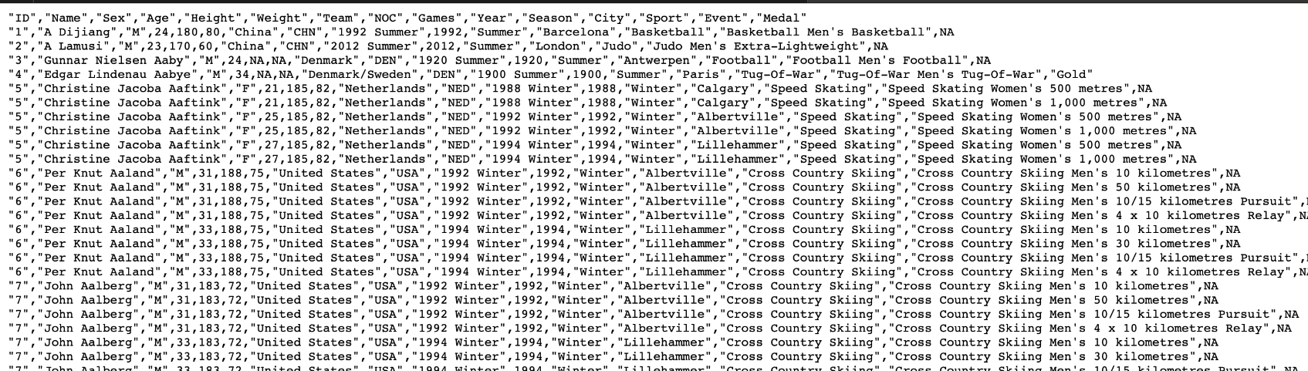

Slide 5
Characteristics of the Data
Occurrences (summer and winter)
Data at the sport level, Art competitions were not included in the athletes’ data (focused on athletics)
large-scale dataset (spans the years 1896 to 2016)

Slide 6
Why

Slide 7
Objectives
Saúl’s intentions for this visualisation is to answer the following questions:
Which countries are the most dominant?
How has involvement evolved?
Which countries have the most medals in various disciplines?
What is the ratio of female/male Olympic attendees?

Slide 8
How

Slide 9
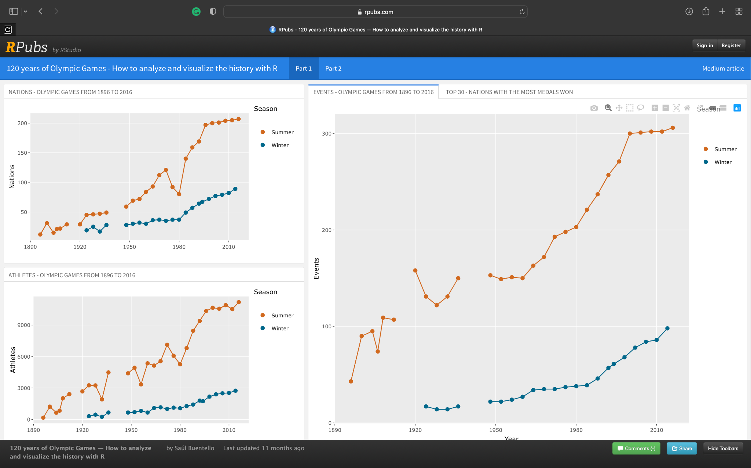
Notes:
Data is for everyone, but is useful to none
Main idea is to redo the visualisation for athletes

Slide 10
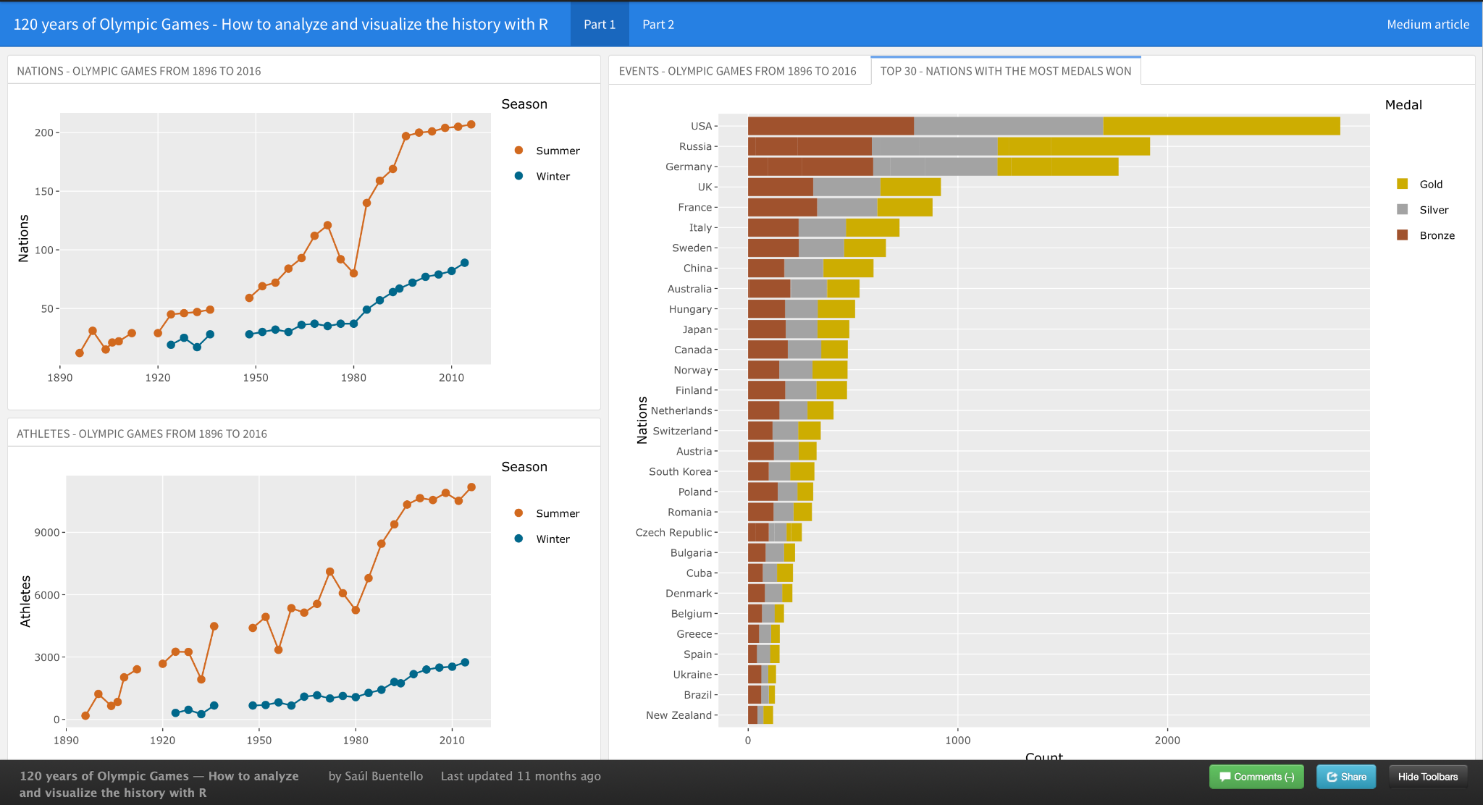

Slide 11
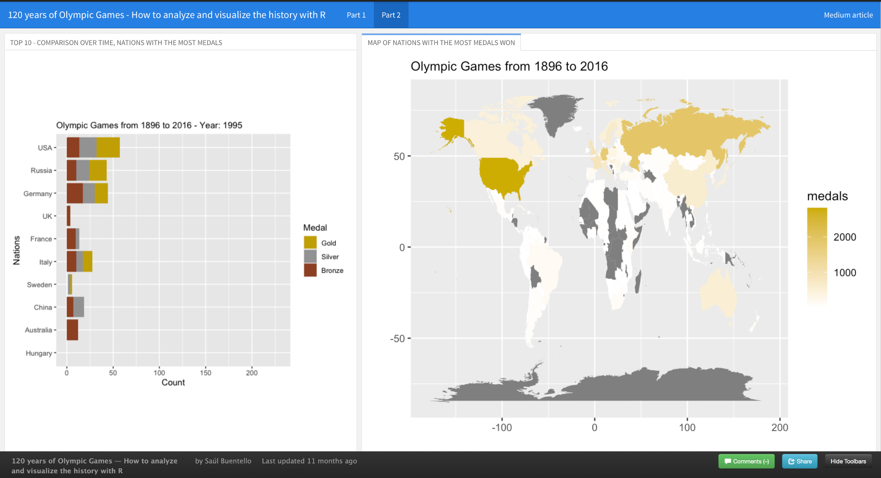
How is the data currently visualised

Slide 12
Did it achieve its intended task?
Which countries are the most dominant?
Yes
How has involvement evolved?
To a certain degree
Which countries have the most medals in various disciplines?
No
What is the ratio of female/male Olympic attendees?
No

Slide 13
Suggestions

Slide 14
What

Slide 15
We plan to use the same dataset

Slide 16
Why

Slide 17
Provide insight for aspiring Olympic athletes

Slide 18
How

Slide 19
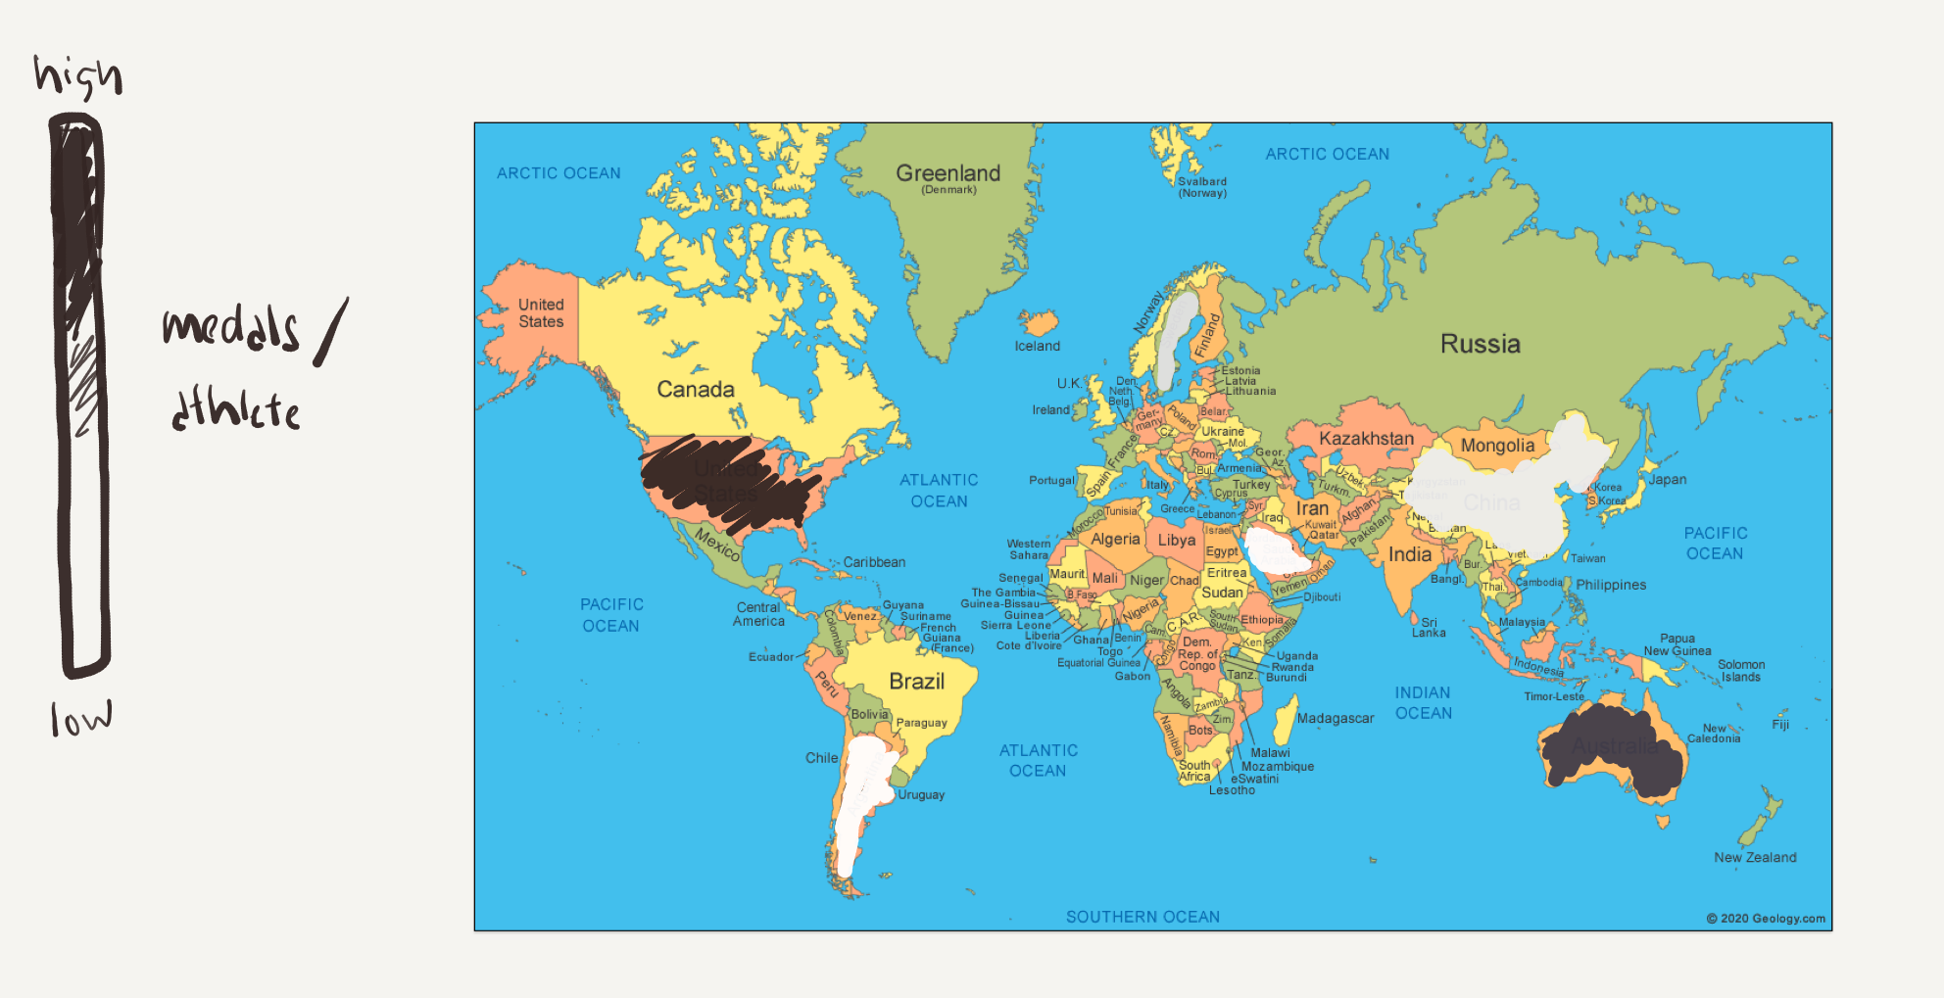
Improvements

Slide 20
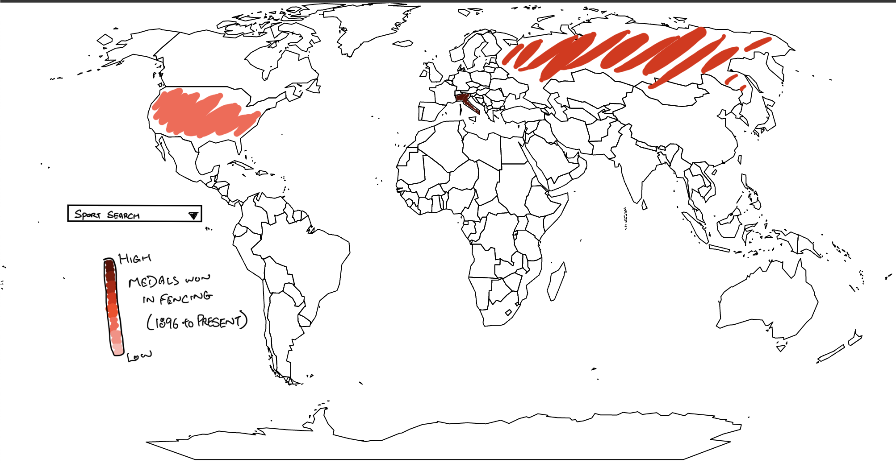
Improvements
Medals won in Fencing:
Gold: 44
Sliver: 43
Bronze: 36

Slide 21
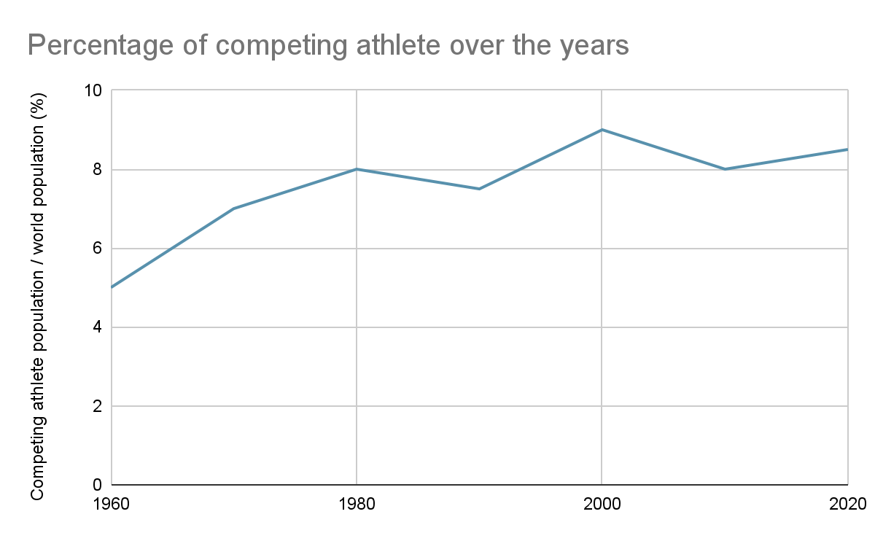
Improvements

Slide 22
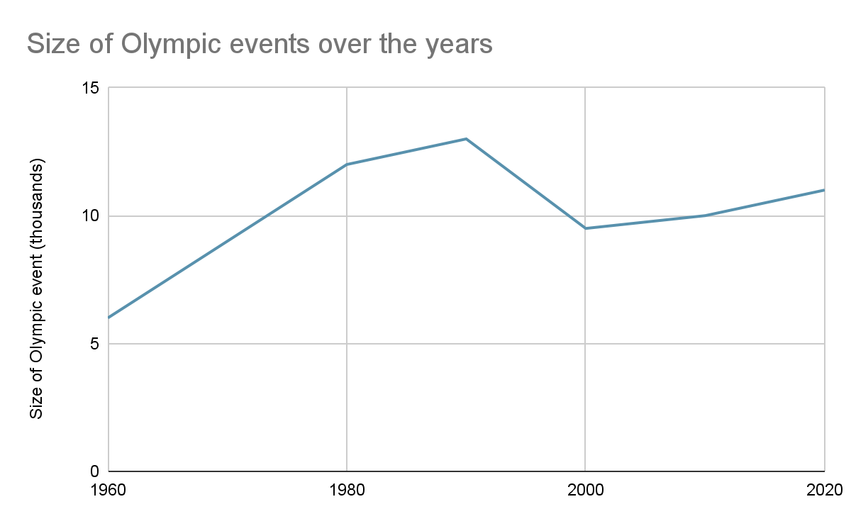
Improvements

Slide 23
Visualization 2
Singapore Automotive Sales Volume

Slide 24
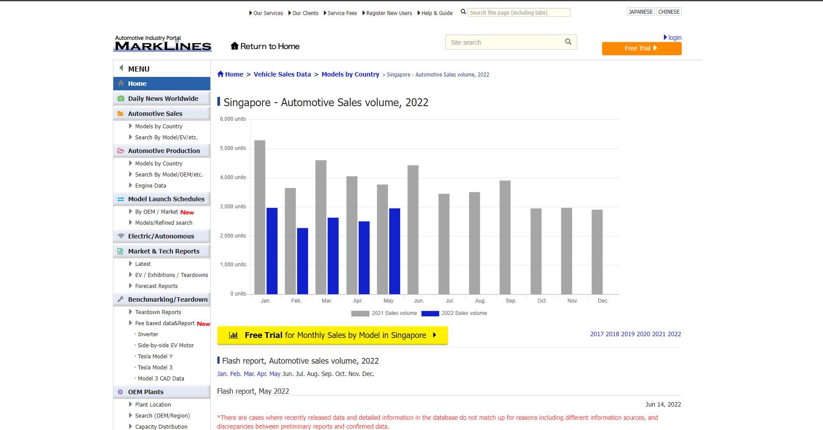

Slide 25
Critique

Slide 26
What

Slide 27
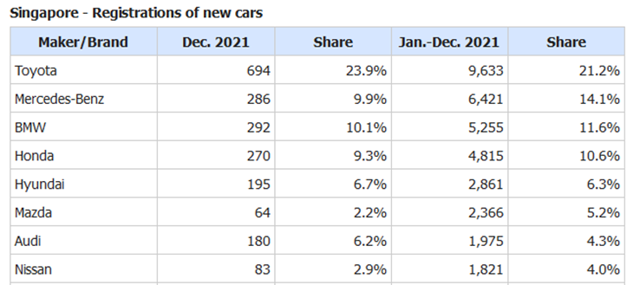
Notes:
New cars sold in Singapore based on the brand of the cars
The sales are broken down into a year-month basis
And shows the percentage sold of a particular brand compared to the total cars sold in the current month/year

Slide 28
Why

Slide 29
Provide accurate information for end-user
Notes:
Suppliers (Spare parts)
Government Sector such as LTA (COE quota)

Slide 30
How

Slide 31
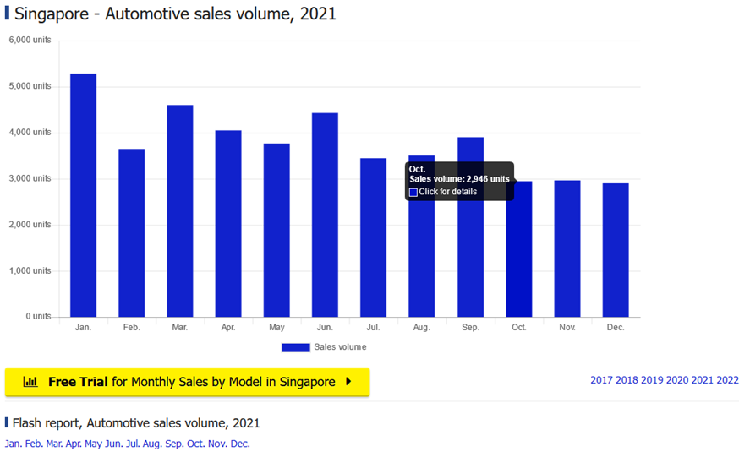
Notes:
This bar-chart shows the sales volume of year 2021

Slide 33
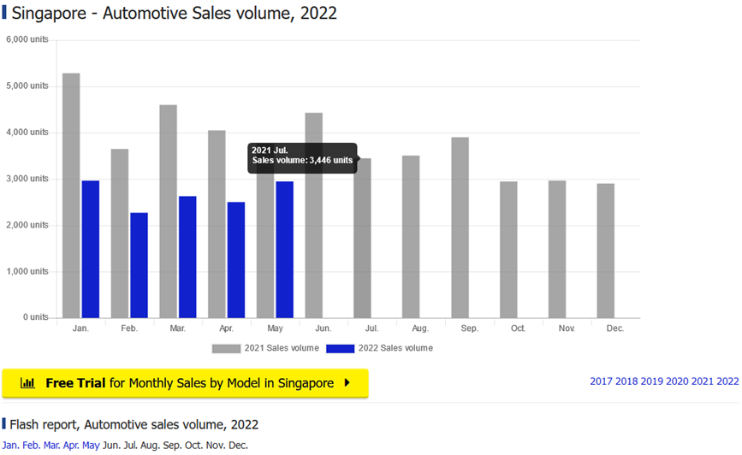

Slide 34
Did it achieve its intended task?
Does it show the consumer trend
Yes, total sales only
Which brands should the suppliers stock up for spare parts?
Hard to visualise from a table
Does it provide any insights of the consumer trend across the years?
Yes, in multiple tables and no visualisation

Slide 35
Suggestions

Slide 36
What

Slide 37
Why

Slide 38
How

Slide 39
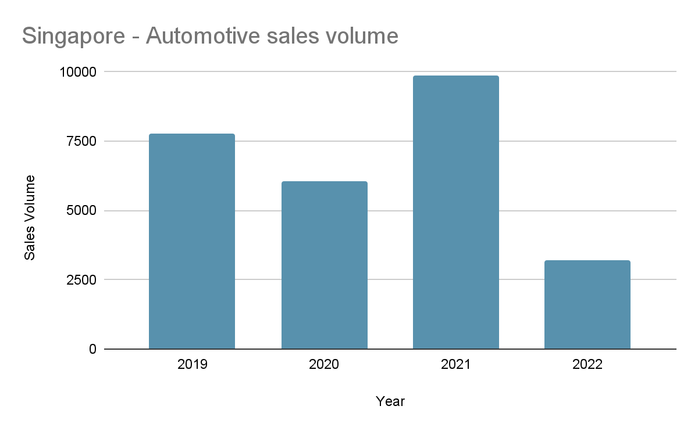
Sales volume by year
Notes:
For the users to better understand how the sales volumes will/ has affected their use case, a breakdown of the sales volume by the years will provide them a high level overview of the sales volume over the years. It also provides the user information on the number of new vehicles joining the read. If the user is interested to view more data with relation to a particular year, they can click on the year they would like to see to open another table to view the sales volume/ month for that year.
This graph is for the users to have a better understanding of how the sales volumes will or has affected their use case.
A breakdown of the sales volume by the years will provide them a high level overview of the sales volumes over the years.
It also provides the user, information on the number of new vehicles joining the read and if the user is interested to view more data with relation to a particular year, they can click on the year of interest which will
open another graph —> Shown here…

Slide 40
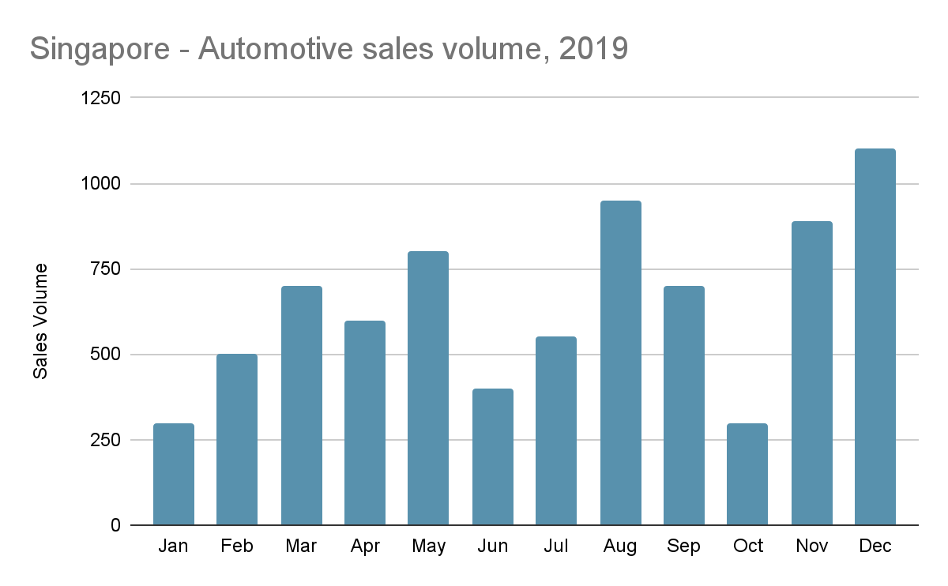
Sales volume by month
Notes:
If the user is interested to view more data with relation to a particular month, they can click on the month to see the breakdown of sales volume for that particular brand in the chosen month.
Shown here… This allows the user to view the sales volume per month for selected year. However, if the user is interested to explore further on the sales of the different car brands in relation to a particular month, they can click on the month of interest. Which will ->

Slide 41
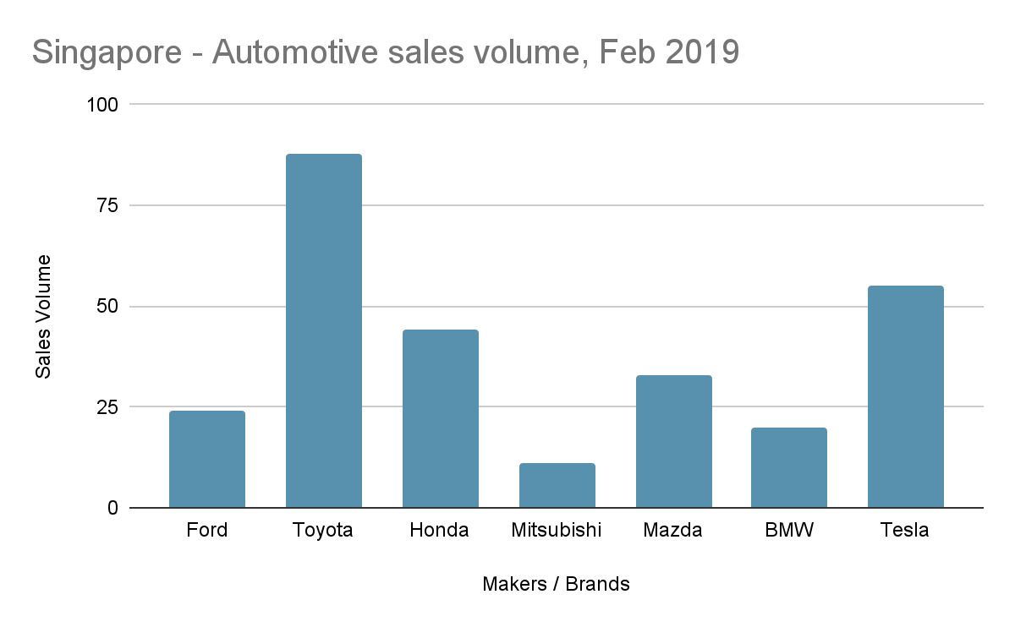
Sales volume by brands for particular month
Notes:
This would provide the users a high level overview of the sales volume of a brand for a chosen month.
Which will… provide the users with a high level overview of sales volume of a brand for a chosen month.

Slide 42
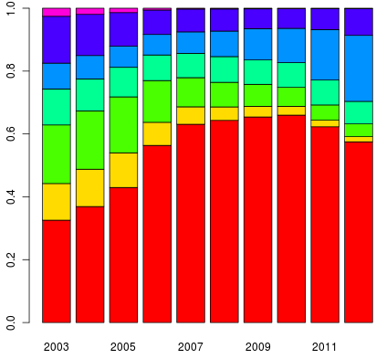
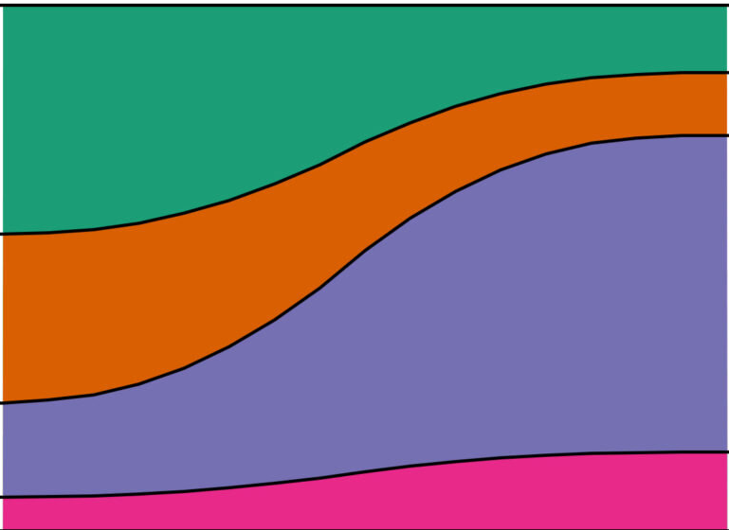
Show market share over years
Notes:
This chart displays the market share over years which was previously displayed as a tabular format mentioned by PK earlier on.
This allows the user to visualise which car brands has a higher percentage of sales volume over the years which can be serve as an indication of the user’s sales.
However, if the sales of a car brand in 2018 only covers 20% of the market share, it does not mean that the 10% market share of the same car brand in 2019 is lower in sales.

Slide 43
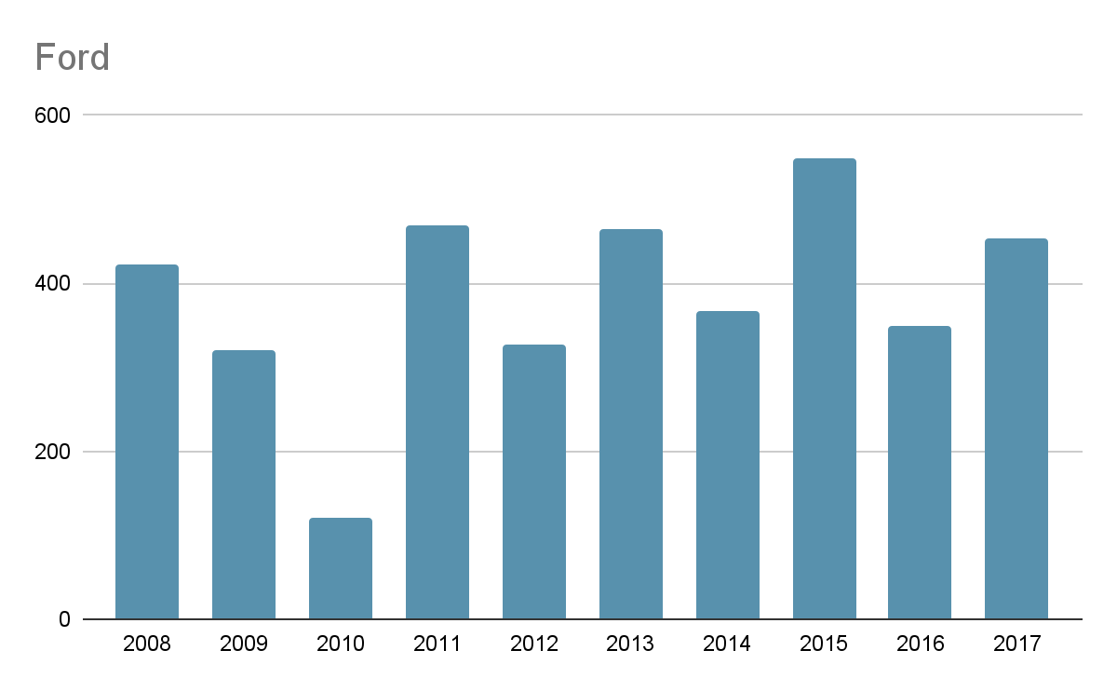
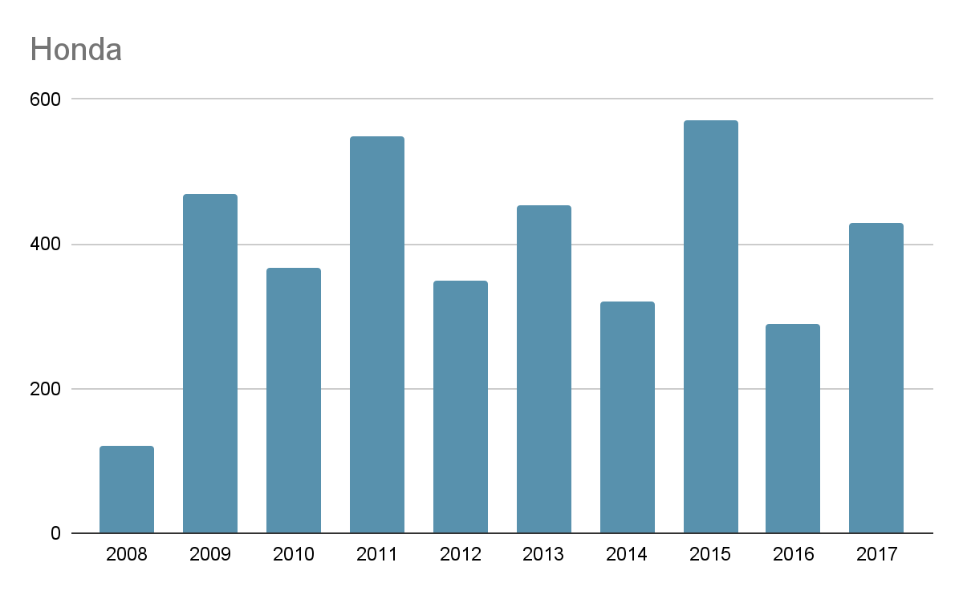
Sales volume by brand over the years
Notes:
In this chart, it shows the raw data of a particular car brand which can be paired with the previous chart to have a more precise numerical values of the market share which was shown in percentage.
This allows the user to make a comparison with their sales on whether the majority of the car owners are using the services provided by the user’s company.
For example, if the user has a sales of 100 deals for Honda cars in both 2008 & 2009, it shows that the sales covers the majority of the Honda owners in 2008. However, in 2009 it only covers the minority.
With this information, the user is able to determine on quality of service being poor and make amendments needed.

Slide 44
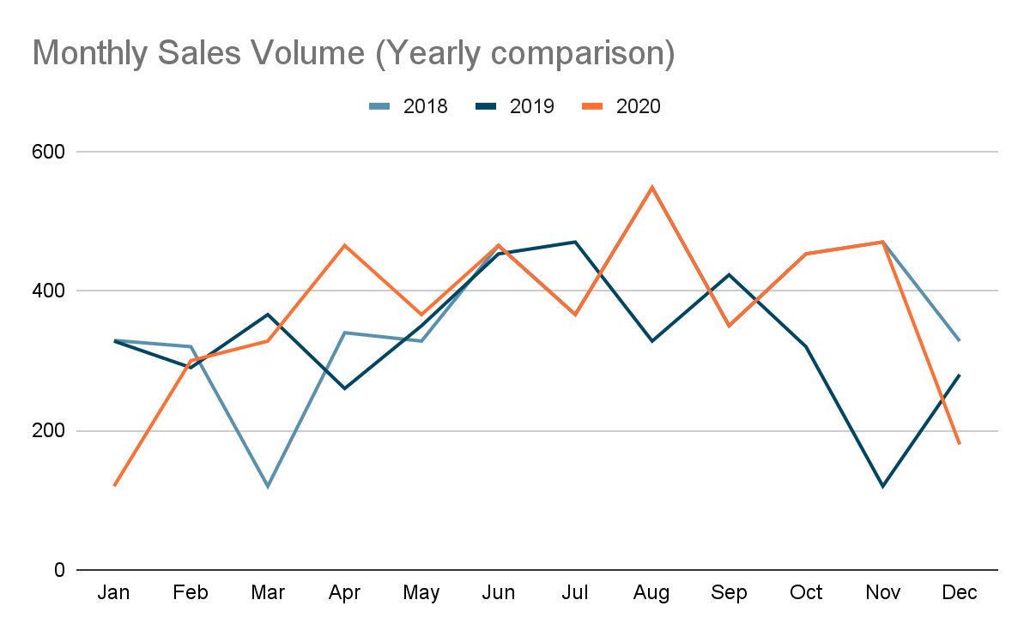
Total sales volume pattern
Notes:
In this chart, it gives an insight on the consumer buying patterns over the months in the different years.
The user can use this insight to predict future trends on the sales volume. E.g. keeping more stocks or bringing more car spare parts in the 3rd quarter of the year

Slide 45
Project Links
Visualisation 1
https://github.com/cosmoduende/r-olympic-games
Visualisation 2
https://www.marklines.com/en/statistics/flash_sales/automotive-sales-in-singapore-by-month

Slide 46
End

